Slide 1
How to run APR and APR detail
For those who has ART license

Slide 2
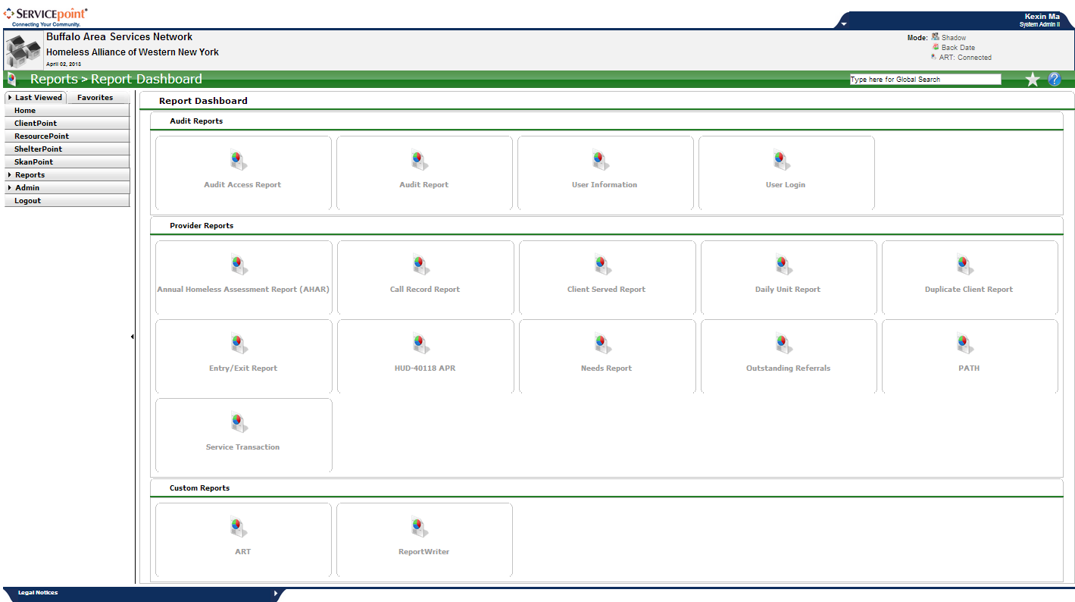
Get to ART:
Click ART:connected on the right-up corner
Or click “reports” then click “ART”

Slide 3
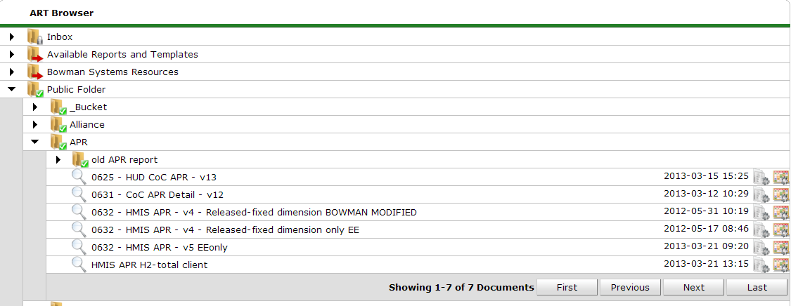
Navigate ART
Click the triangle to navigate ART folder.
APR report is located at “Public folder”→ “APR”

Slide 4
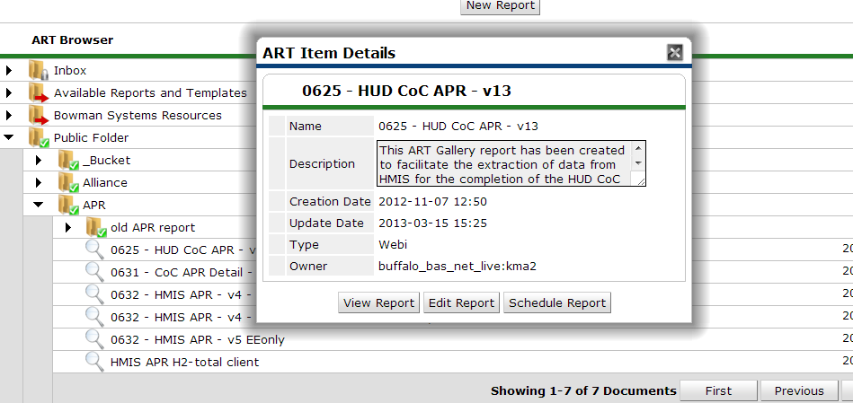
Run report
Click to run the report, the window above will appear
Click “view report”
Always run the newest version of the report.

Slide 5
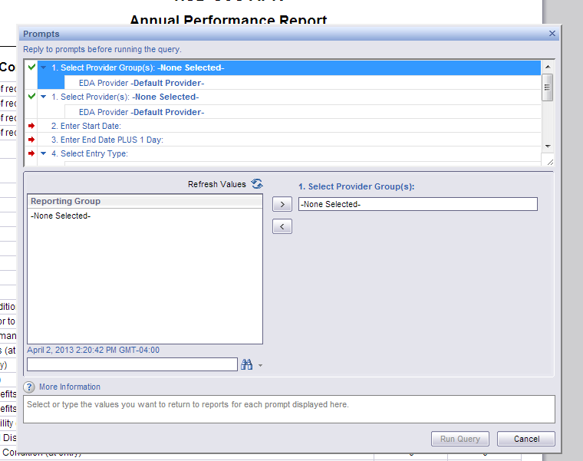
It will lead you to another window, few minutes later this window will pop up. Sometimes it takes a while, please wait patiently.
In the question box, click the question one by one. Scroll down to make sure you answer all the questions.
In the answer box, answer all the questions. Once all the required questions are answered, you can click “Run Query”
Question
Answer

Slide 6
What and How to answer the questions
Select provider group: skip this one if not apply to you
Select provider: select your program
Enter start date: start date of your operating year
Enter End Date plus 1 day: end date plus one day of your operating year
Select Entry type: HUD
Enter adult age: 18
EDA provider: click “refresh value” in the provider box, and select your program
Enter effective date: equal to end date plus 1 day
Is using the Disability Determination field part of your workflow for HUD reporting? Based on your agency
Is using the Receiving Income Source field part of your workflow for HUD reporting? Based on your agency
Is using the Receiving Benefit field part of your workflow f
or HUD reporting? Based on your agency
Is using interim review part of your workflow for HUD reporting? YES
Answers’ options are listed on the left hand box, you can double click option or select the option then click the errors to move option to the right hand box.

Slide 7
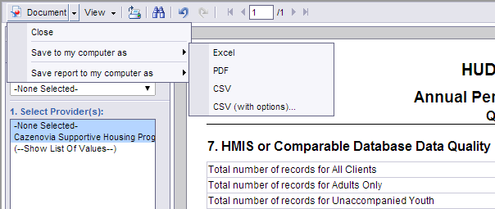
Save it to PDF
Click Documents on the up-left corner
Choose “save to my computer as” to save the whole document. Choose “save report to my computer as” if you only want to save the tab that you are currently reviewing
Choose the format you would like to save.

Slide 8
625 HUD COC APR vs 631 CoC APR Detail
625 report includes question 7-9,12-29, and 36 from your APR and matching the screen on Esnaps. You can use this report to fill out your APR in esnaps.
631 is a client detail report, intent to assist you to locate certain errors that you found in Report 625.
You will first use 625 Report to understand your program number, and if you found that there maybe any mistake, you will then use 631 to locate the mistake and correct it in Clientpoint. Then you will run 625 again to ensure the final numbers are correct to copy into esnaps and submit to HUD.

Slide 9
View report VS Edit report
“View” Report means “run” report.
Viewer license allows user to use “Edit Report” to use the built-in filters in certain reports. Report 631 is one of them. “Edit report” takes longer time and requires a better understanding of the report.
You will first use View report function to run the report. In general, Bowman have already mark or color most of the errors. You can follow those to correct your data. If after all the corrections have been made, there is still error, you will then use “Edit Report”.

Slide 10
Edit Report (Filter function)
Before you use the Edit report function, Please make sure you understand the Report 625 CoC APR, and have a specific question regarding to a specific number.

Slide 11
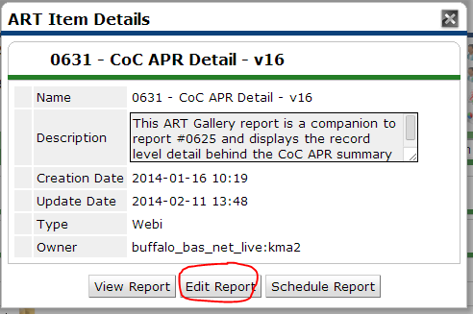
Click the magnify glass→Click Edit Report instead of View Report.
*Note: If you don’t have updated Java, the system will pop you to install a free Java. You will just need to follow the link, download the Java and install it.
The screen will pop you to “Run this time”
Choose “No” when the blocking pop up comes up.
The Prompt with all the questions in slide 6 will show up. No matter you are using View or Edit report, the Prompt questions are the same. Also, 625 HUD APR report and 631 APR detail report’s Prompt are the same.

Slide 12
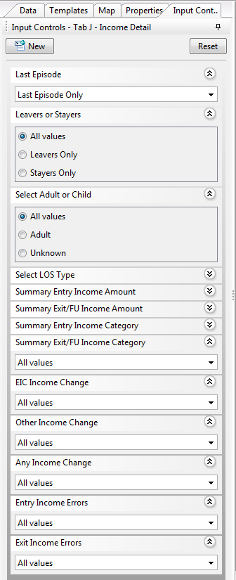
Most Tabs in Report 631 APR detail have built-in filters. If you want to use the filter, you just need to click on the filter’s name and choose the item you want to filter in.
Here I only provide detail instruction for the Income Tab.
If you would like to know the missing on Question 24a (625 report): click Summary Exit/FU income category→ choose “Missing”
If you would like to know if there are any income on ENTRY or on Exit that doesn’t match between “Total monthly income” field and the sub-assessment: Click Entry income errors or exit income errors→select “mismatch”
If you would like to know whose income remains the same/increased/decreased: Click EIC or Other/ Any Income Change: Then select the item fits your need.

