Slide 1
2017 HMIS Data Changes
Homeless Alliance of WNY
September 2017

Slide 2
Agenda & Housekeeping
Takes Effect October 1st, 2017
Data Element Changes
Reporting Updates
SP 6 Updates
Data Quality Updates
Q&A

Slide 3
Universal Data Element Changes
Applies to ALL Projects
Gender
Sexual Orientation
Non Cash Benefits
Destination
Living Situation
Disability
Start Dates
Move In dates

Slide 4
Gender
Wording Change
Required Element
New Wording includes options:
Trans Male (female to male)
Trans Female (male to female)
Gender Nonconforming

Slide 5
Sexual Orientation
New Element
Optional
Will be added to current entry assessment.
This question is already required for some funding partners.
Data collection on this vulnerable population is lacking. HAWNY anticipates this question being required in the coming years.
Self report responses available:
Heterosexual
Gay
Lesbian
Bisexual
Questioning

Slide 6
Non Cash Benefits
Options Removal
Required Element
Section 8 and Temporary Rental Assistance will be removed from the HUD HMIS requirements.
These options will still be available, but will not be counted in the APR.

Slide 7
Destination
Wording Change and Added Option
Required Element
Reworded response
Permanent housing (other than RRH) for formally homeless persons
New response added
Rental by client, with RRH or equivalent subsidy

Slide 8
Living Situation (Residence Prior…)
Wording Change and Added Option
Required Element
New options have been added to the “Residence Prior to Project Entry” question that reflect the new Destination fields:
Permanent housing for formally homeless persons other than RRH
Rental with RRH subsidy

Slide 9
Disability
Option Removal
Required Element
HUD is no longer requiring those “extra” questions such as “Is documentation on file?” and “Currently in treatment?”.
PATH ONLY questions also removed.

Slide 10
Start Date**
New Element
Required
Entry Dates are now called Start Dates for all projects.
Often times, PSH and RRH projects begin serving the clients prior to move in dates. HUD wants to capture that time spent working with a client before they move in to housing.
This change should NOT affect your understanding of when clients “enter” other, non-PH project types (i.e. Street outreach is still at first contact; ES/ SH/ TH is still first night in bed/ residence, etc.)
For current clients in PSH projects who are “engaged” but not “moved in”: Prior to October 1st, do not enter them into HMIS. But after October 1st, you can backdate a “Start Date”.

Slide 11
Housing Move In date
Expanded Element
Required for PSH and RRH
This field now applies to RRH AND PSH projects.
This question will be located in the Interim Review and Entry Assessment for PSH and RRH projects.
Your client’s Start Date is the date you start working with the client towards finding housing.
Your Client's Move in Date will be the date they move into housing.
These can be the same date but your Move In date cannot be before your Start Date.
By using a Start Date, in conjunction with Move in Dates, we will be able to better capture that time spent working with the client for RRH and PSH projects.
Projects other than RRH and PSH will not have this element on their assessments.

Slide 12
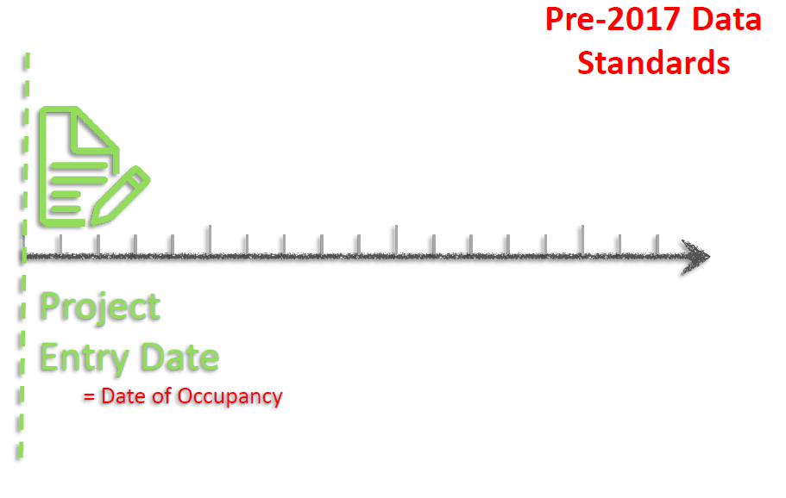
Previous PSH Workflow Diagram

Slide 13
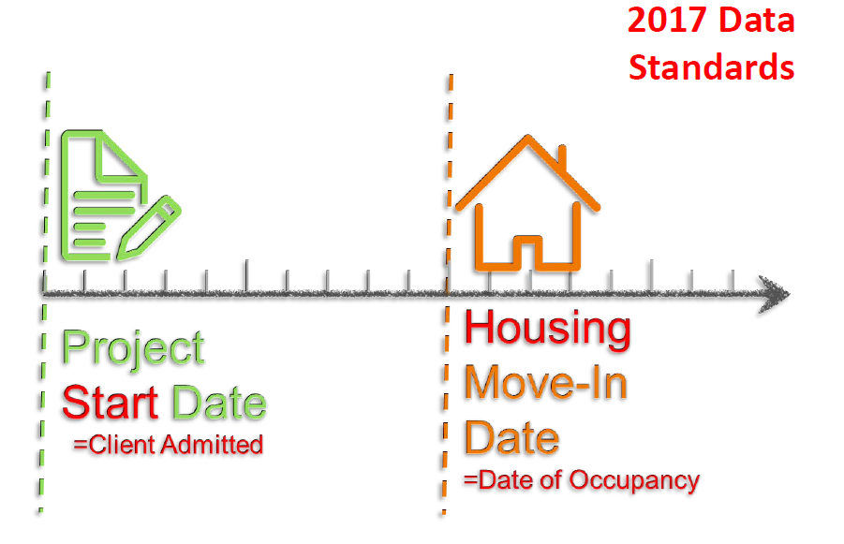
New Workflow for RRH & PSH

Slide 14
Updated Guidance for RRH and PSH
If you work with a client but they do not move into housing, you cannot delete them from HMIS or their Entry/Exit.
We had previously allowed this as HUD was vague on this situation. They have now explicitly stated to not do this.
HUD wants to measure that time spent with the client and use that data to capture why that encounter did not result in housing.
Remember nothing is ever “deleted” in HMIS, only inactivated and we have the capability to monitor this if needed.

Slide 15
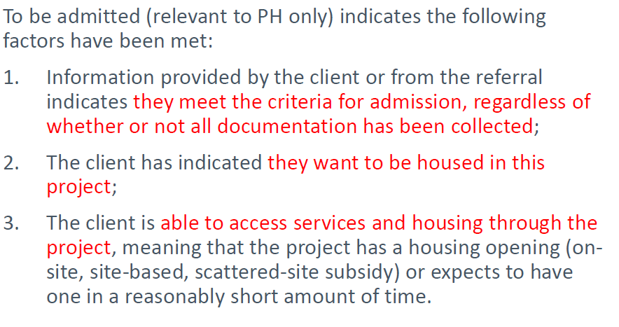
When Is My Client “Admitted”? (For RRH and PSH)
Do not give your client a Start Date in HMIS unless all 3 factors are met. This should reduce the number of clients who do not achieve positive housing outcomes.

Slide 16
Program Specific Data Changes
Only Applies to Specific Project Types:
Outreach ONLY-Date of Contact
Wording Changes.
Location of Contact will be changed to “Was client staying on streets, ES, or SH?” This better matches Living Situation wording.
SSVF ONLY-VMAC
Is now a drop down menu rather than typing in the number.
RHY ONLY-New Elements
-“Is client in counseling?” & “Is discharge safe and appropriate?”
PATH/HOPWA ONLY-Housing Status
For programs that still use this (not many) this will be completely retired and removed from the system. This is a different Housing Status field than used by Coordinated Entry.

Slide 17
Reporting Updates
CoC-APR
Located in “Reports” and is available for all users to run.
APR now gets uploaded to SAGE through a CSV file.
ESG CAPER
Located in “Reports” and is available for all users to run.
Starting October 1st, ESG CAPER’s will also upload a CSV file to SAGE regardless of program year.
E-Cart will be retired.

Slide 18
Servicepoint 6
Still waiting…

Slide 19
Data Quality Updates
We are aware that some projects would like a more comprehensive data quality report and we are working with Mediware to bring this about.
Report Cards will be available in the new reporting system. We just have to wait for Mediware to create it.
In the meantime, the CoC-APR has useful data quality questions that will go over some, but not all, data quality issues.
Remember to add the correct ROI to your client when entering data! The ROI provider should match whatever provider you are entering data under. EDA is useful!

Slide 20
Q&A
Ask us things

