Slide 1
2025 Point in Time and Housing Inventory Count Review
NY-508

Slide 2
Agenda
Intro to PIT & HIC
Overall CoC Numbers
By County Numbers
Household Compositions
Unsheltered vs. Sheltered
Bed Inventories

Slide 3
What are the PIT & HIC?
The Point-in-Time (PIT) Count is a snapshot of how many people are experiencing homelessness—both sheltered and unsheltered—on a single night in January. HUD requires every Continuum of Care (CoC) to conduct these counts each year. It includes people staying in emergency shelters, transitional housing, and Safe Havens, as well as those sleeping in places not meant for human habitation. Each community is responsible for planning, organizing, and carrying out the count locally.
The PIT goes hand in hand with the Housing Inventory Count (HIC) which is a is a point-in-time bed and unit inventory count of projects within a CoC that are dedicated to serving people experiencing homelessness.
This year’s PIT/HIC date was 1/29/2025 and was submitted on 6/13/25
Notes:
This whole process starts sometime in the Fall of each year. Planning involves volunteer recruitment, training, coordinating routes, creating materials, donations, and oversight on the actual PIT night. This is followed up with unsheltered survey collection and data entry. Then we transition to collection of non HMIS data, confirming HMIS bed inventories, and data cleaning where we work with projects so that client counts are accurate in HMIS. Once the data is collected and cleaned we then reconcile and enter the data into the HDS which is HUD’s reporting repository. This is usually May 1st but this year was pushed to June. 8-9 month process or ¾ of the year.

Slide 4
What are the PIT & HIC reporting on?
Overall Number of Clients-This includes all unsheltered clients, sheltered clients in emergency shelters, transitional housing, and housed clients in rapid rehousing and permanent supportive housing projects on the night of the PIT.
Household Composition-HUD separates households into 3 categories; Adult Only, Adults with Children, and Children Only.
Subpopulations-Additional populations such as chronic homelessness, unaccompanied youth, certain disability types, Veterans, and DV.
Bed Inventories-Each project must confirm the number of beds/units available on the night of the PIT. This is used for utilization rates.
Methodologies- How did we plan and conduct the PIT and HIC.

Slide 5
Big Picture
Overall Client Counts

Slide 6
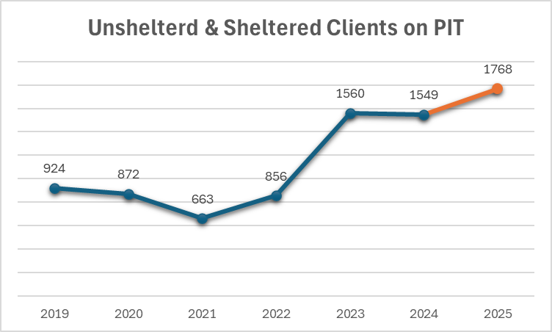
PIT By CoC
This is the overall number of clients in ES/TH and on the street on the night of the Point in Time (PIT).
This year’s PIT number is a 14% increase from the previous year.
Notes:
So why is this?

Slide 7
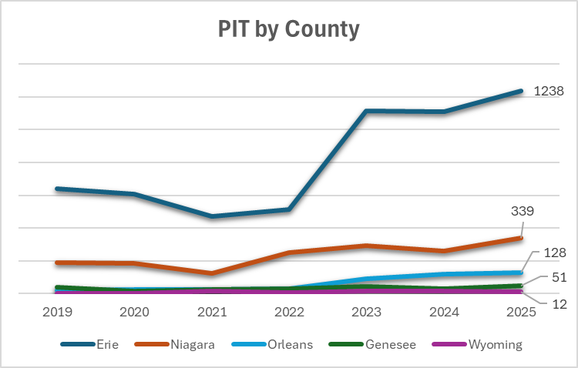
PIT By County
County | 2024 | 2025 | # Change | % Change
Erie | 1125 | 1238 | 113 | 10%
Niagara | 261 | 339 | 78 | 30%
Genesee | 30 | 51 | 21 | 70%
Orleans | 118 | 128 | 10 | 8%
Wyoming | 15 | 12 | -3 | -20%
Total | 1549 | 1768 | 219 | 14%
Notes:
Percentage wise it may seem like a lot but smaller numbers will present as larger % changes.
This past year saw an increase in the number of clients saying Evictions were their primary reason homeless.

Slide 8
Household Compositions
Household counts by HUD types

Slide 9
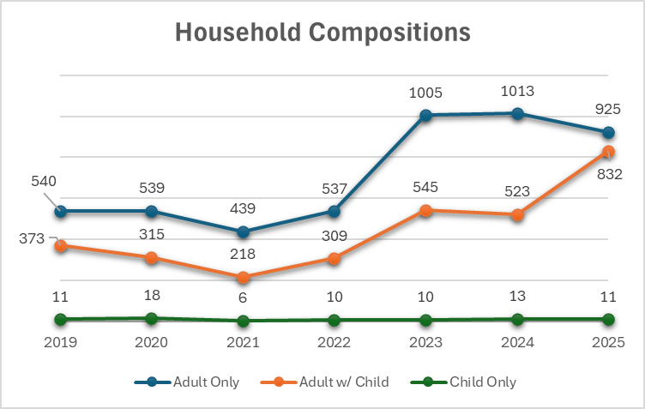
PIT Households
The 2025 PIT saw an increase in Adult with Children Households.
*This is the number of clients in households
Notes:
Increased DQ may have played a role in this year’s A/C HH number, as many projects tend to not enter children’s information into HMIS. This year we concentrated efforts in helping project fix this issue. And while we still believe we saw an increase, the 2024 number may have been slightly lower than it should have been.

Slide 10
Inventories
Beds and units by project type and utilization

Slide 11
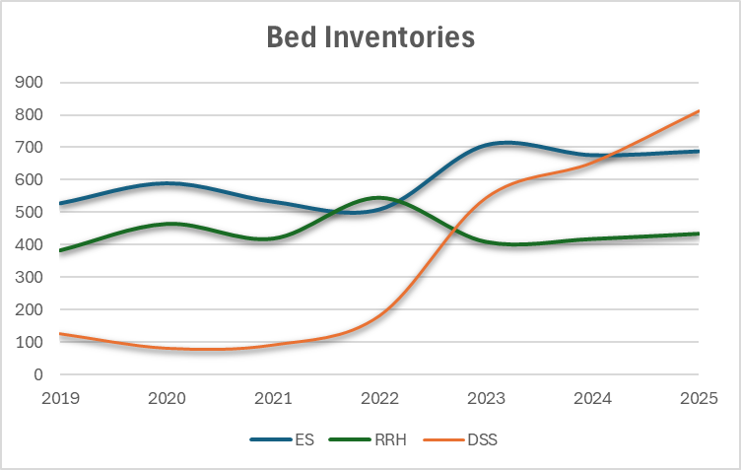
Bed Counts
Lines represent ES, DSS, and RRH Bed Inventories.
DSS motel/hotel beds have increased since Covid dramatically.
Notes:
HUD doesn’t distinguish between as-needed motel beds and ‘normal’ brick and mortar shelters. We have split them out here.
ES beds are physical shelters with capacity limits. DSS beds are motels/hotels used if a physical shelter is not available.
RRH represent housing available (PSH is not on the graph as it has also remained relatively static between 1200-1300 beds and turnover is much lower.)
This is showing that our brick and mortar shelter capacity, while increasing a bit, is not at the level needed in response to the increasing number of those in need.
It also shows that more housing resources are needed, such as RRH.
Utilization rates show that on average 5% of ES beds are available on the night of the PIT with many shelters at capacity.

Slide 12
Unsheltered Counts
Number of clients found on the street during the night of the PIT

Slide 13
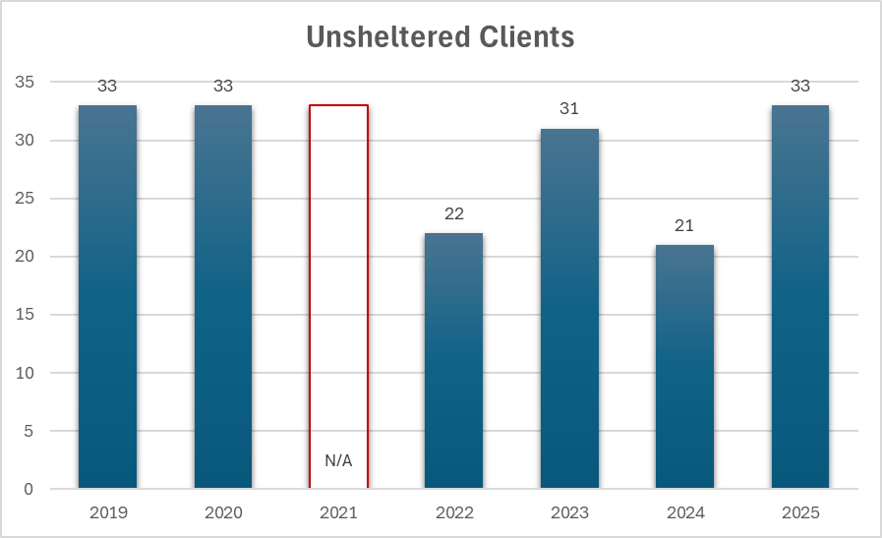
Unsheltered Population
Compare this to the early 2010’s where unsheltered numbers were 50+.
Street Outreach plays a vital role in seeking unsheltered clients and connecting them to services or shelter.

Slide 14
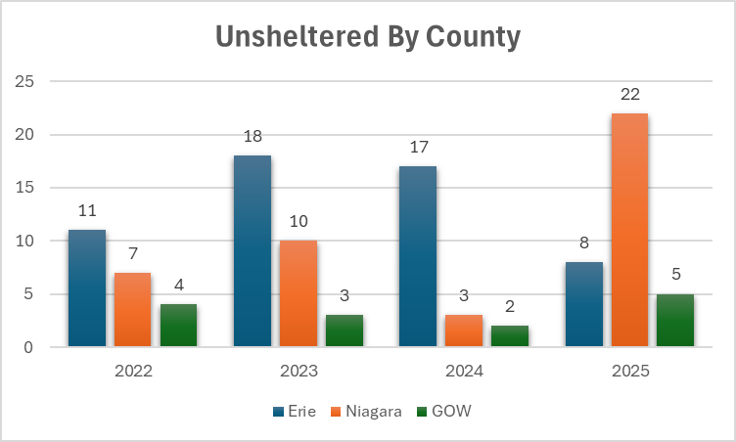
Unsheltered Population By County
This year saw a rise in Niagara County unsheltered which corresponds to an increased Street Outreach effort in Niagara.

Slide 15
PIT Summary
The Point in Time is a community wide effort that relies on teams to seek out unsheltered clients and HMIS projects to submit accurate and timely data.
We saw an increase in clients experiencing homelessness on the night of the 2025 PIT, specifically households with children.
Housing Projects such as RRH & PSH have relatively static capacity, resulting in a bottleneck of clients waiting for housing.
Takeaways
There is a need to increase the number of non-DSS shelters, specifically family shelters.
Affordable housing is more important than ever.
Street Outreach projects continue to be vital in connecting the community to services.

Slide 16
Thank you

