Slide 1
Building Relationships Across Aging and Housing
Buffalo, NY
Sept. 25, 2025
Yolanda Stevens, PhD
Program and Policy Analyst
ystevens@naeh.org

Slide 2
The National Alliance to End Homelessness
(The Alliance)
Founded in 1983 by a group of concerned citizens determined to meet the emergency needs of the nation’s then-emerging population of homeless people.
A nonpartisan, nonprofit organization whose sole purpose is to end homelessness in the United States.

Slide 3
The Alliance, How We Work
We use research and data to find solutions to homelessness.
We work with federal and local partners to create a solid base of policy and resources that support those solutions.
We help communities to implement them.

Slide 4
Our Three Pillars
Policy and Programs
Carries out the vital work of educating policymakers and the field about key strategies and policies for ending and preventing homelessness.
Capacity Building
Supports efforts to end homelessness by offering training and technical assistance tailored to communities’ unique needs.
Homelessness Research Institute
Analyzes data to identify homelessness trends on national, local, and Continuum of Care levels.
Keeps federal policymakers and legislators informed of the needs of people experiencing homelessness and the programs serving them.
Leads advocacy efforts on a grassroots level.
Helps design and implement crisis systems, improve systems’ performance, and utilize data to end homelessness, particularly with an equity lens.
Provides online courses, trainings, and webinars to inform the field of best practices to end homelessness.
Publishes research that ensures policymakers, practitioners, the media, and the public have the best information about trends and emerging solutions to the problem.
Uses an equity lens to identify disparities in homelessness data.

Slide 5
ACL’s Profile of Older Americans
57.8 million adults aged 65 and older
  31.9 million women and 25.9 million men
  Represent 17.3 percent of the population
  Larger percentage of older men (68%) than older women (47%) were married
  Appx. 28 percent of community-dwellers lived alone
  Median income was $29,740 ($37,430 for men and $24,630 for women)

Slide 6
ACL’s Profile of Older Americans ‘cont.
More than 9.3 million experienced depression
Almost 7 million were food insecure
Appx. 11 percent live in poverty
Nearly 11.8 million households with an adult age 65 or older experienced housing cost burden
Nine million adults aged 65 and older with limited incomes are eligible for but not enrolled in programs that can help them afford food, Medicare, and other daily expenses

Slide 7
America’s Evolving Older Adult Population
Those age 65 and older are the fastest-growing segment of the population.
The older American population is also growing more diverse. While 75% of today’s older adults 65+ are non-Hispanic white, that percentage will shrink to 60% by 2050.

Slide 8
HUD’s Definitions of Homelessness
“Homeless” or “at risk of homelessness” includes not only people without shelter, but also people who will lose their housing within 14 days and neither have a subsequent residence nor the resources to obtain other permanent housing.
Other “homeless” individuals include some people exiting institutions (prisons, nursing homes, etc.) after temporary stays of 90 days or less.
“Chronically homeless”- people with a documented disability who have been continuously homeless for at least a year or have had repeated episodes of homelessness amounting to a year.
Recent federal reports estimate that adults aged 55 and older comprise more than one-third of adults with chronic patterns of homelessness.

Slide 9
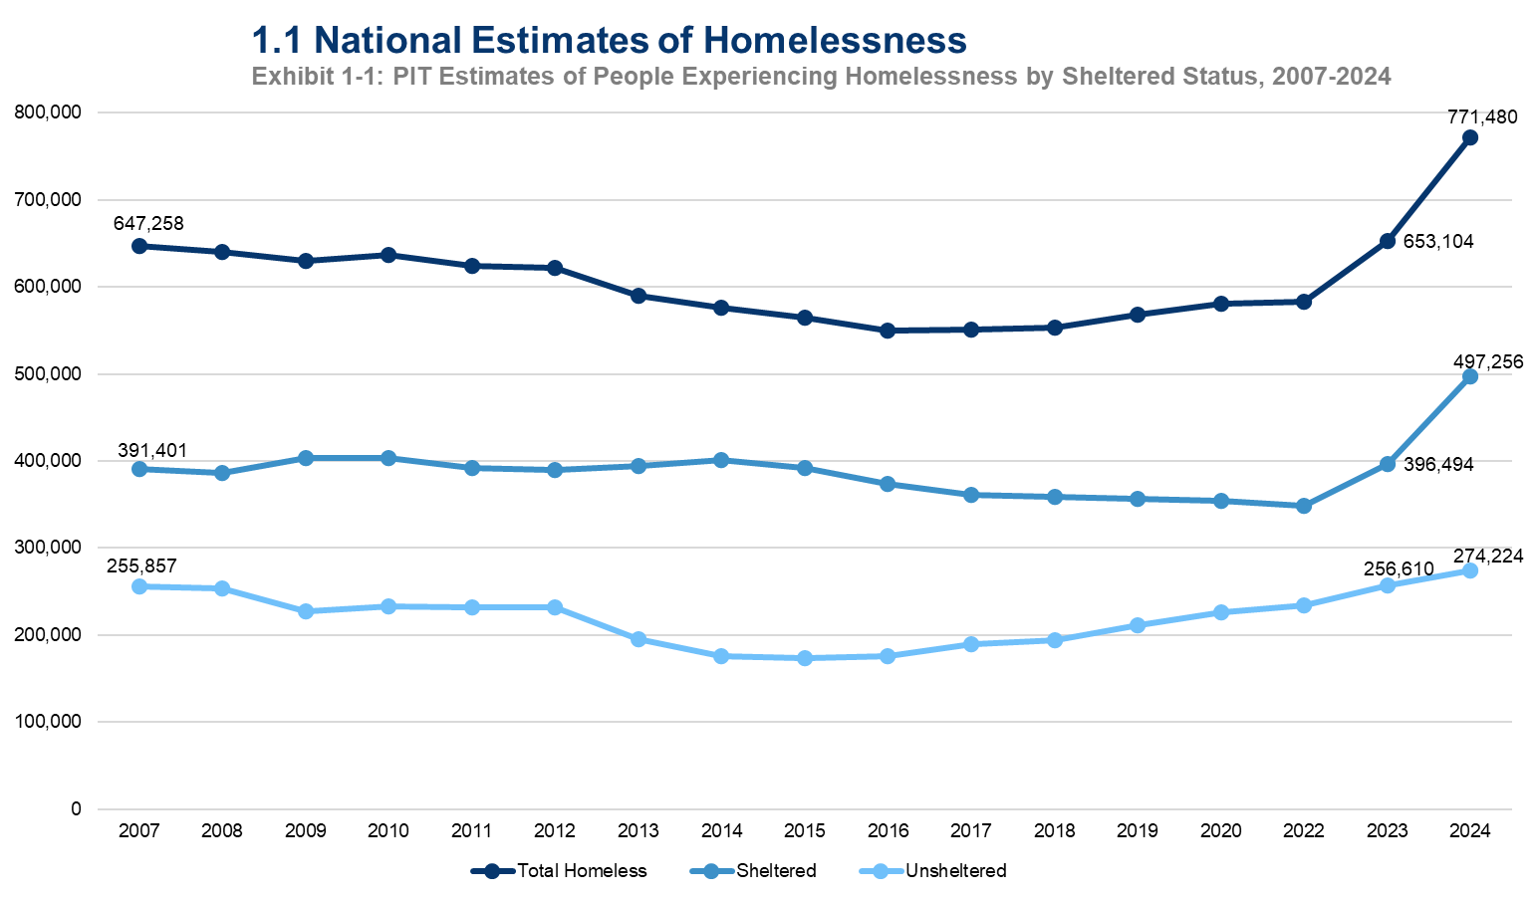

Slide 10
Homelessness Among Older Adults
Growing Population—fastest growing segment of the homeless population
Pathways to Homelessness—community-level vs individual risk factors
Unique Needs—older adults aged 50 and older have rates of chronic conditions that resemble those of housed older adults who are 15-20 years older

Slide 11
Growing Population
More than one in five people experiencing homelessness on a single night in 2024 was aged 55 or older.
Nearly half of adults aged 55 or older (46%) were experiencing unsheltered homelessness (residing in places not meant for human habitation).
Number of unhoused people 65 and older could triple by 2030.​

Slide 12
Pathways to Homelessness
Community-level factors such as lack of accessible, affordable and available housing and limited safety net resources.
Individual risk factors, such as medical problems, health-related behaviors such as substance use disorders, social factors (e.g., social isolation, barriers to transportation), and financial insecurity.

Slide 13
A Closer Look at the Pathways
Adults who experience homelessness for the first time before age 50* tend to have:
  adverse experiences,
  substance use disorders, and/or mental health challenges;
  been involved in the justice system; and/or were under-employed early on in life.
*structural impacts
Adults who first experience homelessness at age 50 and older typically have:
  experienced a financial or health crisis,
  lost a loved one, or otherwise experienced a relationship breakdown with the income-earner,
  and/or experienced barriers to continued ability to work.

Slide 14
Unique Needs
Chronic health conditions
Cognitive concerns
Mobility limitations
Fixed incomes

Slide 15
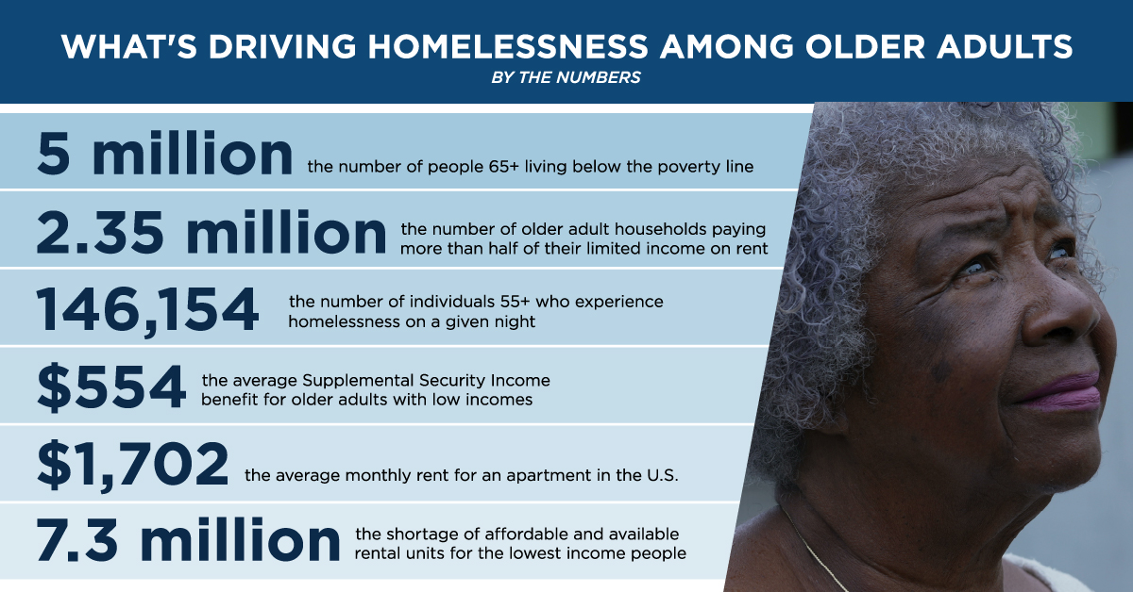

Slide 16
“The moral test of government is how that government treats those who are in the dawn of life, the children; those who are in the twilight of life, the elderly; and those who are in the shadows of life, the sick, the needy and the handicapped”.
~Hubert H. Humphrey

Slide 17
Lessons from Marriage for Impactful Human Services
Knowledge Sharing: Know what you bring to the relationship
Communication: Talk it out
Collaboration: It takes two (or more)
Commitment: For better or worse
Love: The heart of it all
Tools: Leveraging of resources

Slide 18
Know What You Bring to the Relationship
Aging and homelessness professionals each bring unique perspectives and tools.
Honor and leverage expertise.
Don’t try to be everything. Know your role and trust your partner’s role.

Slide 19
Talk it Out
Build structures for regular, honest and transparent communication across sectors.
Communication is key.
Connection builds collaboration.

Slide 20
It Takes Two (or more!)
No single agency or professional can “solve” homelessness or aging challenges alone.
We need true inter-agency partnerships, not just MOUs or referrals.
Partnership means shared goals, mutual respect and accountability.
Real change happens when we work in unison

Slide 21
For the Better
Show up…don’t check out.
Commit to your clients and to the long game…system change, housing first, aging in place, equity.
No quick fixes, in it for the long haul…for better

Slide 22
Love
Means compassion, dignity, respect and the belief that every person is worthy of safety, care and connection.
We need integrated approaches that see the whole person rather than a category.
Love is not a soft skill; it’s a powerful tool of human connection.

Slide 23
Knowledge Sharing
Housing and Services Resource Center
  Created to serve people working in organizations and systems that provide housing, homelessness, health, independent living, and other supportive services that help people live successfully and stably in the community
Housing and Services Partnership Accelerator
  Created to help states improve collaboration and leverage new flexibilities and funding to reduce homelessness by addressing health-related social needs, such as housing-related services

Slide 24
Collaboration
The Alliance for Aging, Inc., in Miami, Florida, initiated communication with the Miami-Dade County Homeless Trust and providers of emergency shelter and housing to improve access to services available through the Aging Network. Coordination has increased bidirectional referrals to improve access to housing, Medicaid, and long-term services and supports for people at risk of or experiencing homelessness.
AAA Region One and the Justacenter in Phoenix, Arizona are major partners in a daytime shelter for adults aged 55 and older who are experiencing homelessness.
San Diego County’s AAA and Serving Seniors studied local needs and then created a series of trainings on aging issues for several hundred homelessness service providers. Other collaborative projects include prevention programs, such as rental subsidies, and they are exploring ways to provide both assistance with activities of daily living and age-friendly features in shelters.

Slide 25
Commitment
All In Federal Strategic Plan on Homelessness
Multi-Sector Plan on Aging
Strategic Framework for National Plan on Aging
U. S. Senate Special Committee on Aging
U.S. Senate Committee on Health, Education, Labor and Pensions (HELP)

Slide 26
Leveraging Resources
The Alliance
  Center for Capacity Building
    Caring for Older Adults Experiencing Homelessness (for service providers)
    Caring for Older Adults Experiencing Homelessness (for system leaders)
  Homelessness Research Institute
  Policy and Program
HUD
  HUD Exchange
  CoCs

Slide 27
Leveraging Resources ‘cont.
Advancing States
  Advancing States
JIA
  Housing and Homeless Prevention
USAging
  Resources: Aging and Housing/Homelessness

Slide 28
Advocacy
Sign Up for Alliance Advocacy Alerts - National Alliance to End Homelessness
How to Advocate to Your Lawmaker - National Alliance to End Homelessness
Get Involved
  It is always a good time to speak with your Representatives and Senators about ending homelessness. If you would like to get more involved, please email the Alliance’s Senior Field Organizer, Samantha Wood (swood@naeh.org).

Slide 29


