Slide 1
Renewing Our Pledge: A Path to Ending Lead Poisoning of Buffalo’s Most Vulnerable Citizens
Poverty Research Workshop
April 5, 2019

Slide 2
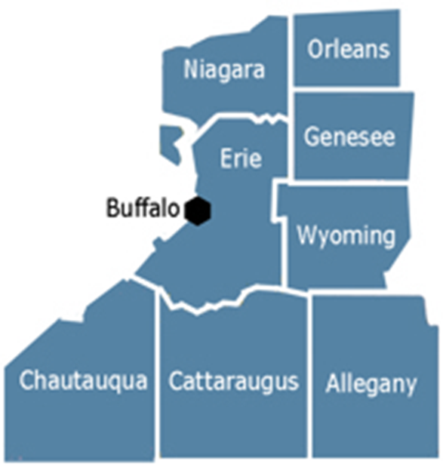
Community Foundation Quick Facts
Established in 1919
Over $485M in total assets
Population in the City of Buffalo: approx. 260,000
At or Below Poverty Level: 30.5% of households
Notes:
Mission: Connecting people, ideas and resources to improve lives in Western New York.
Vision: A vibrant and inclusive Greater Buffalo region with opportunity for all.
So a brief overview of the Community Foundation for Greater Buffalo…
So this year is a really big year for us because we are celebrating our Centennial
And though we’re based in Buffalo our focus area is comprised of eight counties bordered by Lake Erie and Lake Ontario
However, in regards to this research, we are focusing on the City of Buffalo because it is home to our most vulnerable residents.

Slide 3
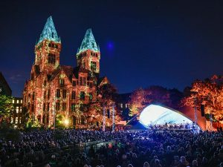
Four Strategic Goals
GOAL 1 GOAL 2 GOAL 3 GOAL 4
Education
Improve educational achievement and workforce readiness for residents living in low-income neighborhoods.
Racial Equity
Increase racial/ethnic equity.
Environment
Protect and restore significant environmental resources and promote equitable access.
Arts and Culture
Strengthen the region as a center for architecture, arts and culture.
Notes:
Our involvement with healthy housing and lead poisoning tie into our four strategic goals. Every five years the Foundation engages in a robust strategic planning process to evaluate the upcoming needs in the community and determine where we can make the biggest impact. Increasing Racial and Ethic Equity and improving educational achievement and workforce readiness for residents living in low-income neighborhoods are two of our main priorities and why the Foundation entered into the Healthy Housing space back in 2010.

Slide 4
Risks of Lead Exposure
Lead poisoning causes permanent neurological damage, which can lead to lifelong learning difficulties
In Erie/Niagara, children from neighborhoods of color are 12x as likely as children from predominately white neighborhoods to test for EBLL
There is no safe level of lead
Notes:
Loss of IQ points and decreased attention span
Behavioral Problems (e.g. hyperactivity)
Impaired growth and hearing loss
At very high levels, seizures, coma, and even death
Long term connection to violent crime
As seen in our Greater Buffalo Racial Equity Dividend Report, Children residing in neighborhoods of color are 12x more likely than children residing in predominately white neighborhoods to test for Elevated Blood lead Levels.
We know there is no safe level of lead and we know the longer you are exposed, the worse the effects. One of the reasons this is such a difficult fight is because lead is often found in the place we are supposed to be the safest, in our own homes.

Slide 5
Healthy Housing and Lead Poisoning
Second oldest housing stock
53.9% youth living in poverty
3x higher rate than Flint, MI
Clint
Changing Community Needs
Notes:
Old housing built before 1978 when lead paint was banned coupled with high rates of poverty causing a lack of maintenance has resulted in Buffalo’s high rates of lead poisoning. Moreover, Buffalo is unusual in the heavy predominance of smaller, wood framed buildings as opposed to building types such as brick apartment buildings. So it is not just the age, but the type of housing that makes Buffalo an unfortunate leader in elevated blood lead levels.
Buffalo has the second oldest housing stock in the nation, with 93% of the homes built before 1980. That means Buffalo has over 120,000 housing units that may contain lead paint. While many may not have exposed lead hazards, in under-resourced neighborhoods many homes do due to significant deferred maintenance.
While the crisis in Flint, MI brought renewed attention to the issues around lead exposure,, unlike Flint, The principle source of lead contamination in Buffalo is lead-based paint in homes constructed before 1978. Reuters found the lead poisoning rates in Buffalo are 3x higher than in Flint.

Slide 6
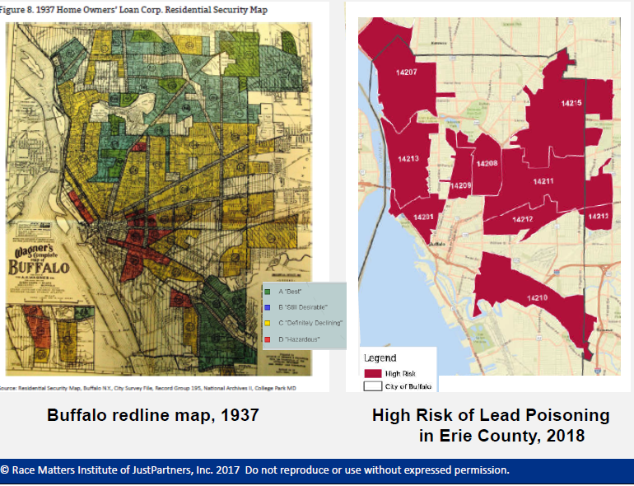
Redlining and Lead Poisoning
Notes:
I think it is important to note that while deferred maintenance is a major issue, it should not be looked at in a vacuum. We acknowledge there is a lot of victim-blaming and shame around lead poisoning and that is part of the narrative we are trying to change. One just needs to look at our past to understand our present.
Buffalo is the 6th most segregated city and has a history of segregation through redlining and restrictive covenant practices which caused many neighborhoods to enter a downward spiral of disinvestment. Those same neighborhoods can also be found labeled as “communities of concern” by the NYS Department of Health today for lead poisoning.
The Community Foundation acknowledges that the lead poisoning problem we see today is a direct result of structural racism in our community and it is our communities responsibility to address it.

Slide 7
Community Lead Action Plan
Community Foundation Engaged Center for Governmental Research (CGR) and the Partnership for Public Good with funding from early childhood funders and City of Buffalo
Goal: To develop a high-impact and collaborative community action plan to reduce lead poisoning among Buffalo’s children.
Notes:
The Community Foundation convenes the WNY Coalition to Prevent Lead Poisoning and brought this issue to the group. The Coalition determined we needed a study with recommendations everyone could agree on, so we brought the idea to the early childhood funders and several agreed to co-fund this study:
Health Foundation, Tower, Wilson, Oishei, the United Way and also the City of Buffalo.
With the funding in place, we were able to engage with Center for Governmental Research who did a similar report in Rochester a few years ago and Partnership for the Public Good to do community engagement work so we could also lift up the voices of stakeholders.
The Action Plan is intended to provide community stakeholders, decision-makers, and funders with an understanding of the landscape of lead poisoning in Erie County and strategic recommendations that will then inform the successful creation of a strategy to eliminate lead poisoning in our community.

Slide 8
Major Findings
Notes:
For the purpose of this presentation, I will focus on the major data findings in the report. However the full report, including the recommendations for policy change can be found on the Community foundation website.

Slide 9
Lead Testing Rates
Erie County has one of the highest blood lead testing rates in the state with 61% of children born in 2012 tested twice by age 36 months.
Notes:
NYS DOH calls for kids to be tested 2x before 3 years old (12 months and 24 months)
61% is great, but 100% is the goal
ECDOH has aggressively sought ways to increase testing rates through regular outreach and continuing communication with pediatric offices across the county.
WNY Lead Resource Center is also working with physicians offices across the county to ensure testing compliance and reporting compliance.
This data is a bit problematic as we know doctor’s offices do not always report when a test is given, especially if it comes back clean.

Slide 10
Lead Poisoning Rates
Lead poisoning rates in Erie County have plateaued in recent years.
Notes:
Erie County’s EBLL rates have been consistently higher than the rest of NYS due to our high risk factors including deteriorating, older housing stock and many young children living below poverty line.
While we saw improvement in the early 2000s, the rates have plateaued in recent years. Some of you may have heard the County Executive’s announcement at the State of the County that lead poisoning rates (10 mcg/dL) went down in 2018.
While we are encouraged to see a drop last year, we are aware that our work must continue to make this downward trend sustainable.

Slide 11
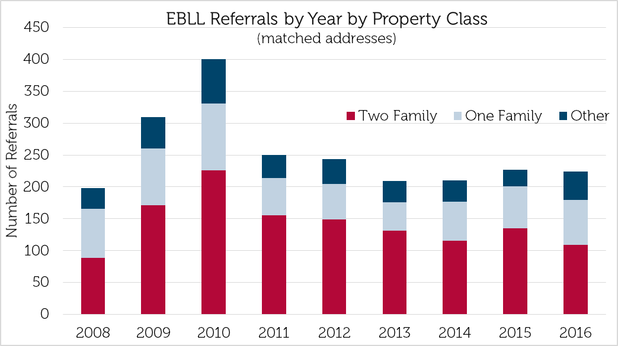
Where is the lead?
The majority of children with Elevated Blood Lead Levels (EBLLs) live in City of Buffalo single and double family homes.
Notes:
For the first time ever the city housing data was overlaid with the Erie County health dept data on lead poisoning to truly identify where the greatest lead hazards are showing up most frequently.
As you can see from the graph, the majority of EBLL cases are people residing in two-family homes, followed by single-family homes.

Slide 12
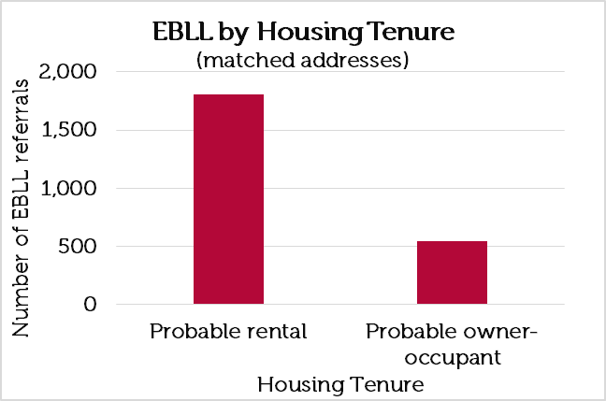
Rental vs. Owner-Occupied
Over 80% of the properties where children are lead poisoned are rental properties.
Notes:
Knowing that lead poisoning disproportionately effects people living in low-income neighborhoods, its no surprise that the vast majority of elevated blood lead levels are found in rental properties.
the majority of rental properties are owned by over 1,200 different property owners. – problem is not with a handful of property owners who own multiple units.
Contrary to the common narrative, in the City of Buffalo, roughly 50% of landlords reside in the same neighborhoods where they own their rental properties. 25% reside in the suburbs and 25% reside out of the area.
Knowing that the majority of the lead issues lie in rental housing helped inform our recommendations

Slide 13
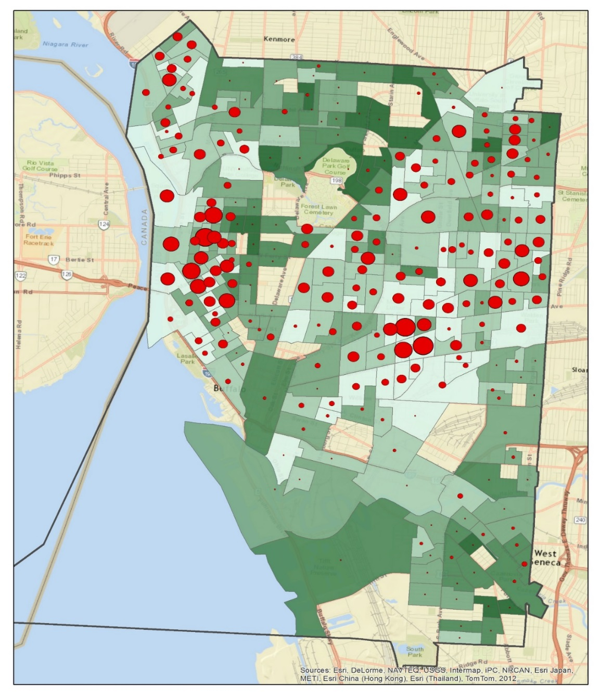
Poverty and Lead Poisoning
Lead poisoning is more frequently found in low-income neighborhoods.
However, when lead poisoning occurs, the average EBLL is similar across all neighborhoods and incomes.
Notes:
The lighter the green color, the lower the household income for that neighborhood
The larger the circle, the more reported EBLL cases in that area
While it should come as no surprise that lead poisoning occurs more frequently in low-income neighborhoods, what we learned here is that if lead poisoning occurs, regardless of income level, the EBLL or severity of the poisoning tends to be the same.

Slide 14
Peer Cities
Heightened awareness and improved policy have generated best practices in reducing lead poisoning in peer cities.
Notes:
To help inform our recommendations, we looked to peer cities with similar risk factors to find best practices
We learned heightened awareness and improved policy makes a difference but more importantly, we learned policy alone does not create change. Municipalities need the proper resources to enforce policy if it is going to work.

Slide 15
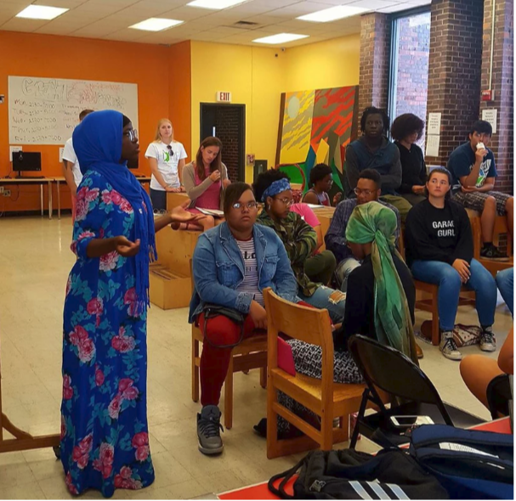
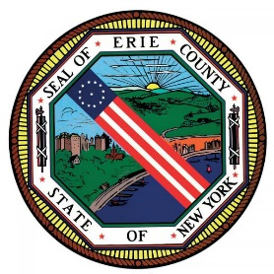
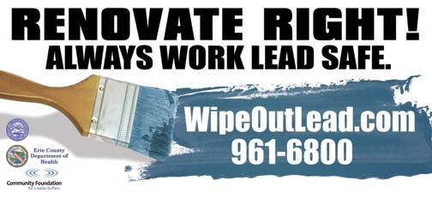
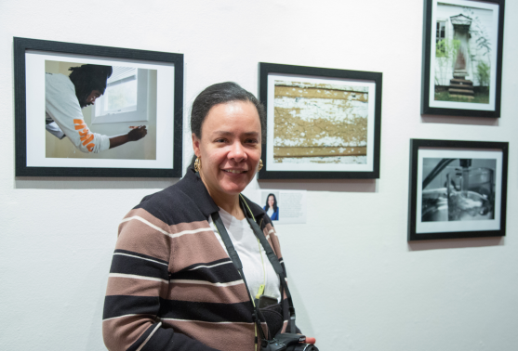
Addressing the issue
Notes:
The Community Foundation believes in Collective Impact and we know we cannot solve this issue alone. We are grateful to the cross-sector partnerships we work collaboratively with to prevent lead poisoning in our community.
We have taken a multifaceted approach to this work as we know that the problem exists within many systems and without their engagement, we won’t move the needle.

Slide 16
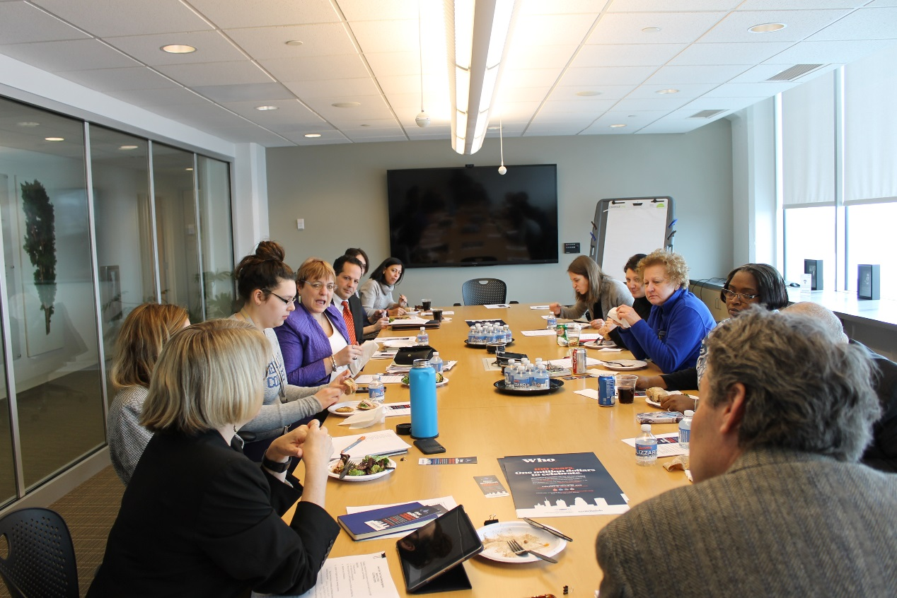
Lead Safe Task Force
Comprised of a cross-sector of community members
Grounded in data from the report
Thoughtful plan for policy change
Notes:
The first approach to come out of the Lead Action Plan was to form the Lead Safe Task Force of Buffalo and Erie County. It was formed to work purposely across sectors to reduce childhood lead poisoning. The Task Force is comprised of representatives of institutions that can take direct action and/or influence actions that will affect systems change, including: the City of Buffalo, Erie County Department of Health, the Buffalo Public Schools, WNY Lead Resource Center at the John R. Oishei Children’s Hospital, and Housing Court. In addition, the Task Force will require representation of stakeholders whose experience and voices will inform real change for neighborhoods and families, including non-profit leaders, philanthropy, property owners, parents, and the WNY Coalition to Prevent Lead Poisoning.
The Task Force is charged with prioritizing the recommendations from the Community Lead Action Plan. The Task Force will build a thoughtful plan for policy change with an emphasis on primary prevention, develop focused work groups, and ensure that the community is engaged in preventing lead poisoning over the long term.

Slide 17
Convergence Partnership of the Tides Foundation
Racial Equity Impact Analysis Tool
Cultural Competency & Trauma-Informed Approaches
Community-Led Policy Advocacy
Narrative Change
Arts Integration
Notes:
We are grateful to the Convergence Partnership for the opportunities this grant is providing us and our community to engage with residents and grassroots organizations in an intentional and human-centered way.
In an effort to move local public policy to a more proactive approach of prevention as recommended by the Lead Action Plan, we took a multipronged approach to this work that includes:
Grasstops training (Common Council REIA)
Direct Service Worker trainings (City Dept Permits and Inspections and ECDOH Sanitarians)
Resident engagement and trainings (CHW training)
Narrative change (from fear based to asset-based)
Arts integration
To deepen understanding of equity issues and foster self-determined communities

Slide 18
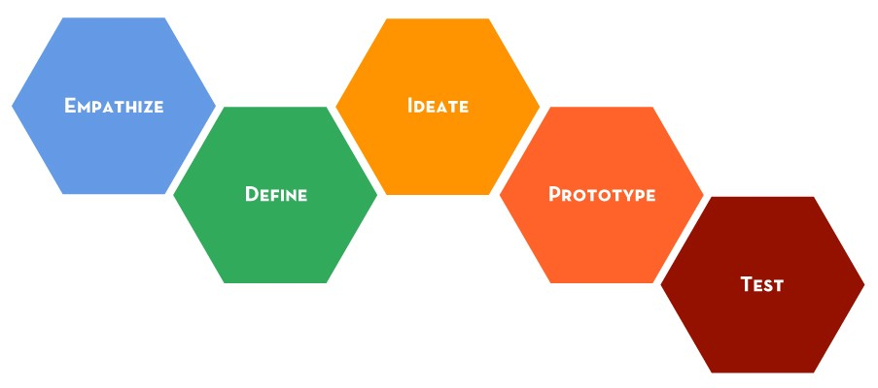
Landlord-Focused Communications Campaign
Notes:
The lead safe task force is addressing policy change and some of the outreach and education to various groups. The Convergence Partnership grant is taking a top down and bottom up approach to engage stakeholders. But the missing critical stakeholder is the landlord.
We are taking a human centered design approach to creating a campaign that will be a positive, asset-based messaging platform for landlords, empowering the community via multiple calls to action that help keep homes safe from lead.
This will be accomplished through a targeted engagement campaign to increase the use of maintenance and repair practices/services that reduce lead exposure in residential properties. This effort is framed by the recommendations in the Community Lead Action Plan.

Slide 19
What can you do?
Be on the look out for chipping and peeling paint
Maintain a healthy diet
Clean windows and household objects
Wash hands & Remove shoes
Join the WNY Coalition to Prevent Lead Poisoning
Call 311 to have your water and your home tested for lead
Notes:
Chipping and peeling paint, especially around doors and windows, is often the source of lead dust in the home. When the City or the County do a visual inspection on a home built before 1978, that is what they look for.
Foods that help decrease lead absorption: foods rich in calcium, zinc and iron. milk and milk products, green leafy vegetables, canned salmon and sardines, calcium fortified-foods like tofu, orange juice
311- or to file a complaint

Slide 20
Questions? KatieP@CFGB.ORG

